Slide 1
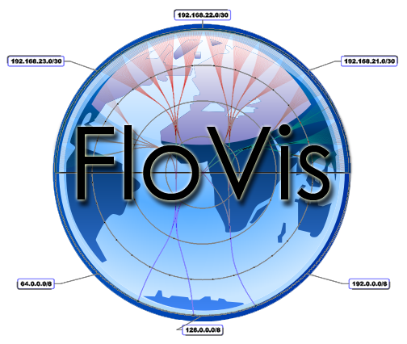
OverFlow: An Overview Visualization for Network Analysis
J. Glanfield, S. Brooks, T. Taylor, D. Paterson, C. Smith, C. Gates, J. McHugh

Slide 2
Outline
FloVis: crash course
OverFlow
Motivation
Description
Case Study
Future Work & Conclusions

Slide 3
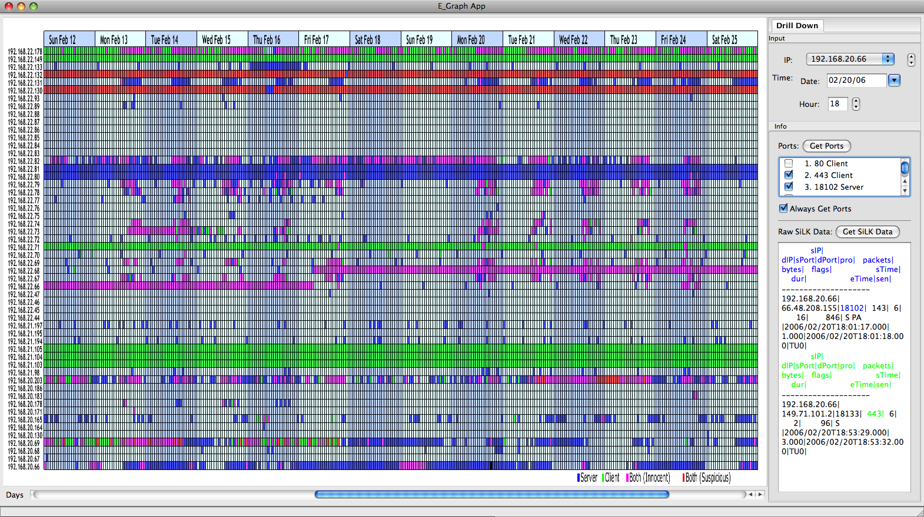
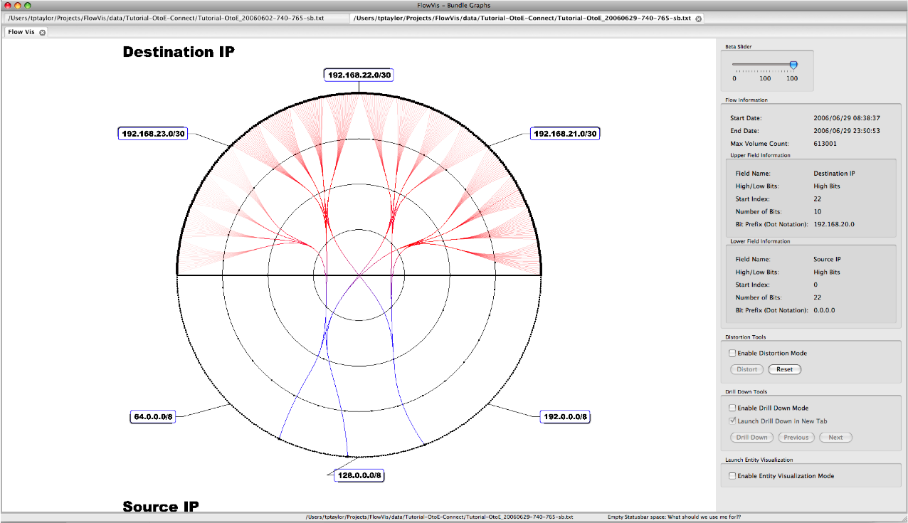
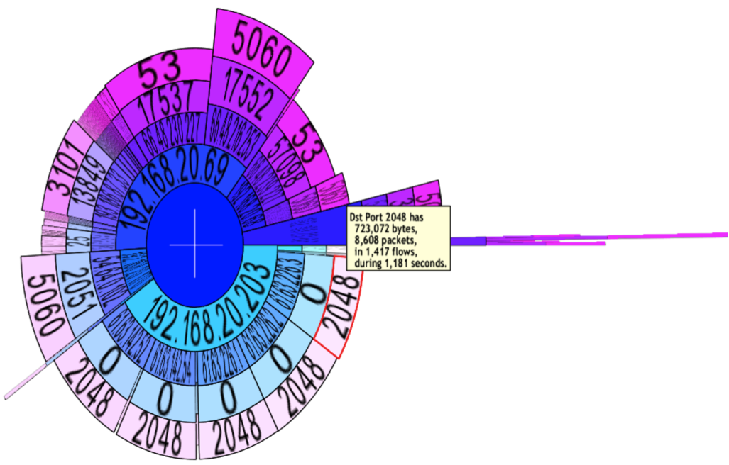
FloVis: Crash Course
Network Visualization Framework
Promotes extensibility
Users create plug-ins
Supports transitioning/pivoting
Viz-to-viz communication
Currently in progress…
Notes:
The purpose of this slide is to give a brief and simple description of FloVis
The next few slides will give a brief intro to one of the plugins, FlowBundle. This will serve two purposes:
1. Those who are new to FloVis will get more of an intro into what has been done
2. It will help me to argue to the need for a starting point (or overview) visualization

Slide 4
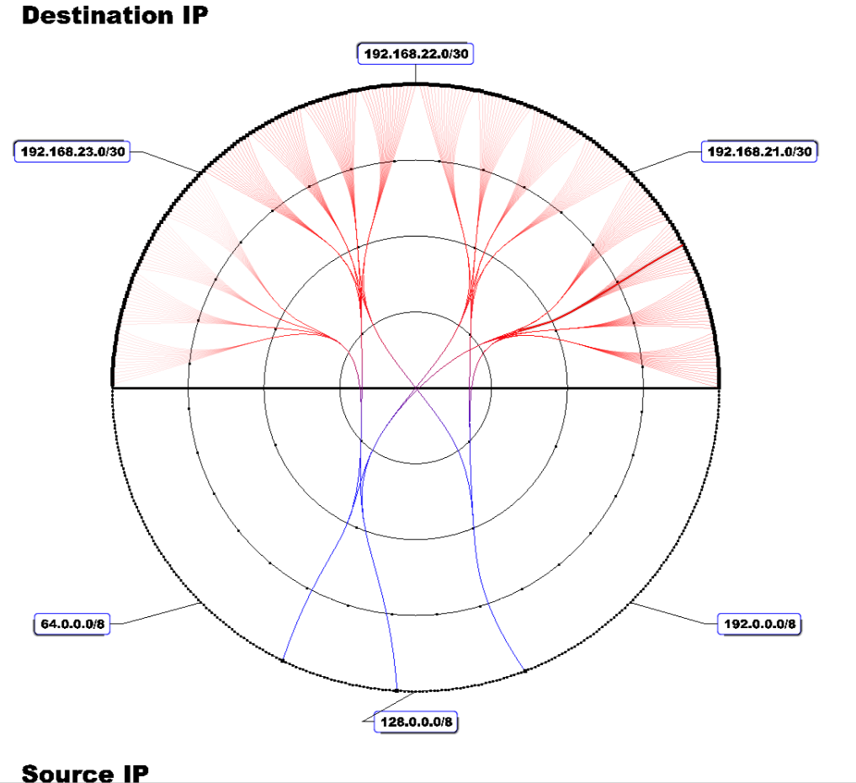
Example: FlowBundle
Notes:
- Do you see that nice red line? Wow, that’s a nice red line!

Slide 5
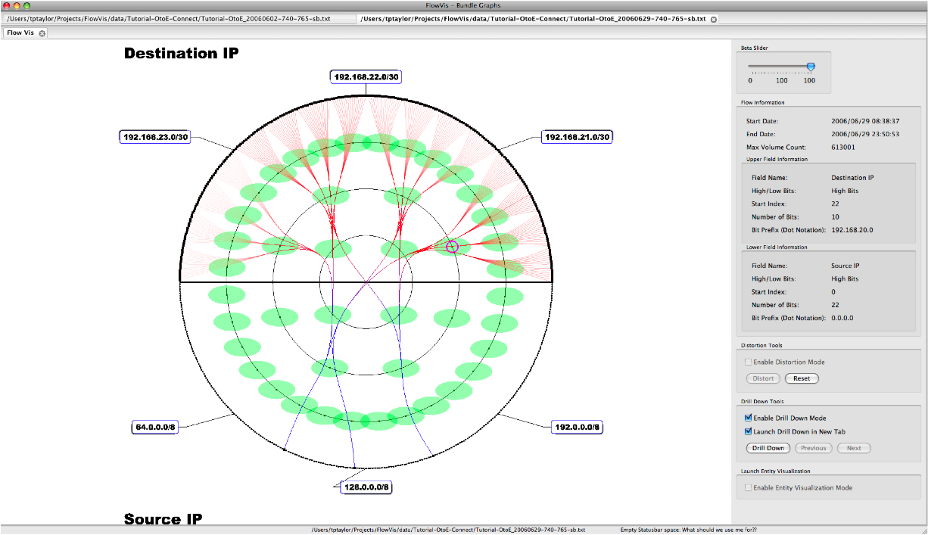
FlowBundle: Drill down
Notes:
This will not be a detailed description of how drill-down works with FlowBundle, but rather just an illustration that it can be done

Slide 6
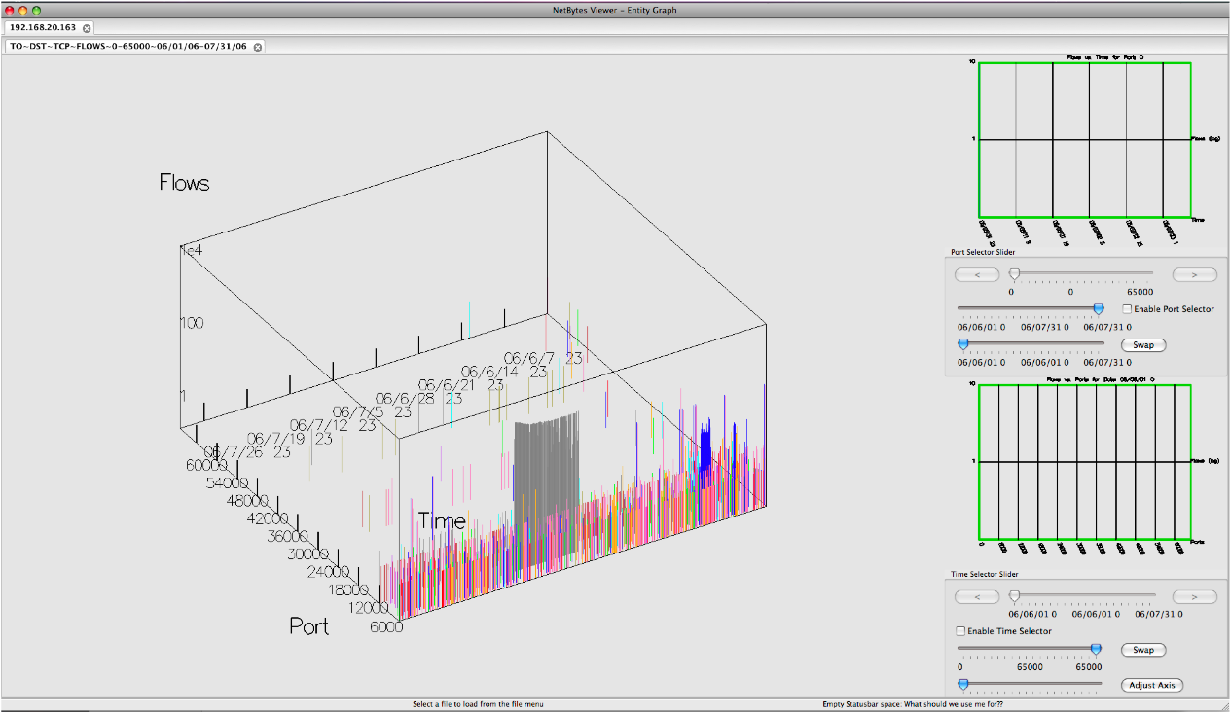
Drill down: continued
Suspicious!

Slide 7

Question!
What motivated the original query?
trial-and-error?
Hmmm… nothing here!
Nothing here either!
New data set
New data set
I hate this job…

Slide 8
OverFlow: Motivation
We need a starting point
We don’t want to go back to the data every time nothing is found worth investigating
(reduce “cognitive load” or “cognitive burden”)
FloCon 2009: analysts described need to group IPs
Organizational groupings
Top-N lists
Etc.

Slide 9
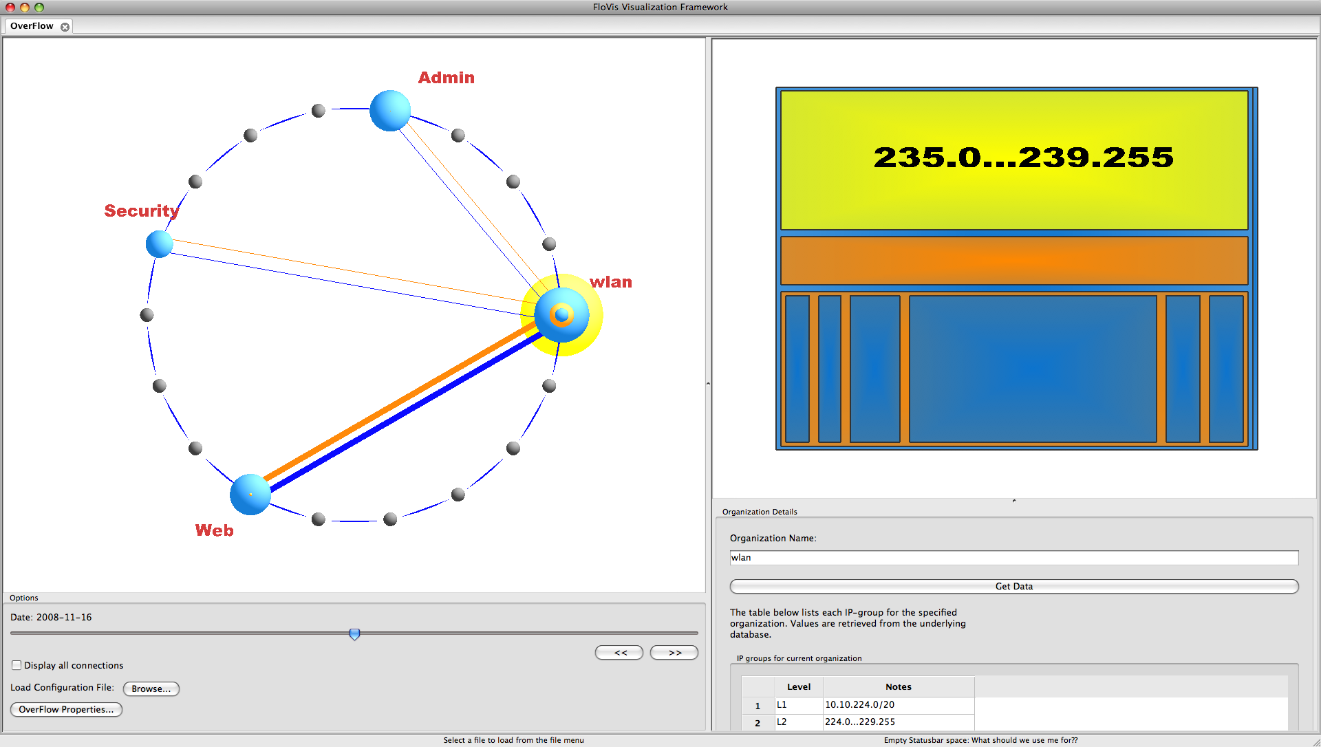
OverFlow
Notes:
Explain the various portions of the interface
note, the treemap now has labeling on mouse over events

Slide 10
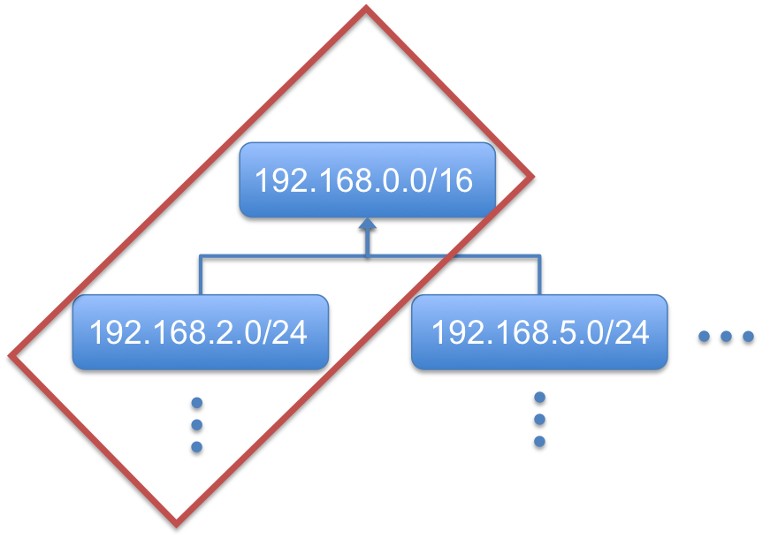
Data Representation
Organize arbitrary network hierarchies:
By hand:
192.168.0.0/16
192.168.2.0/24
192.168.5.0/24
Or:

Slide 11
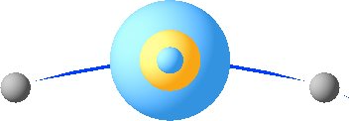
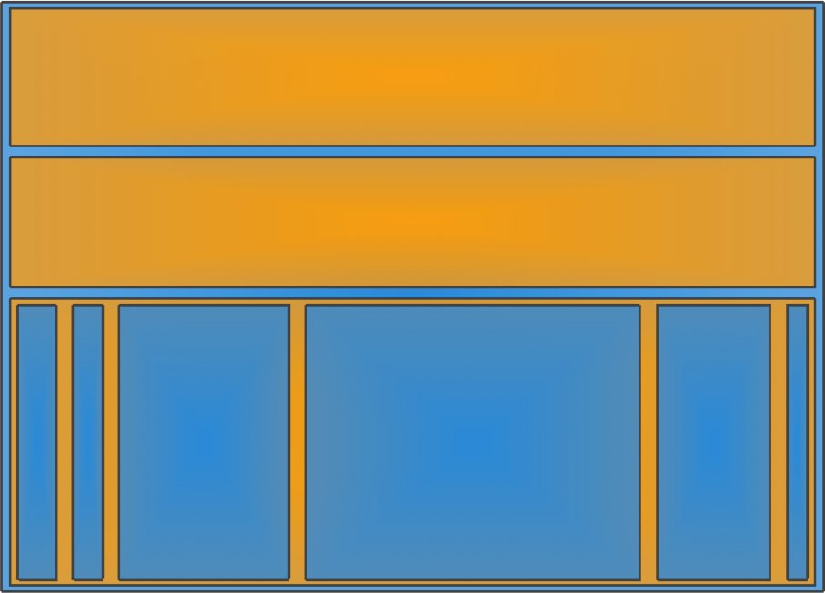
Visualizing Hierarchies
Notes:
- Here is where I will describe how we go from a handwritten hierarchy to various visual representations

Slide 12
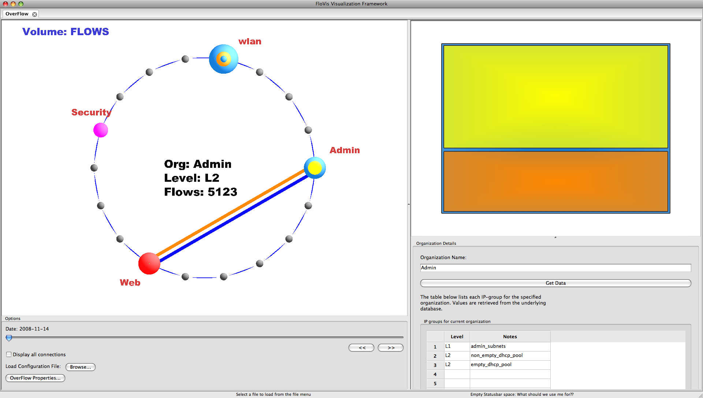
Visualizing Volumes
Notes:
- The next three slides (inclusive) are shown very quickly to demonstrate that we can change the volume attribute

Slide 13
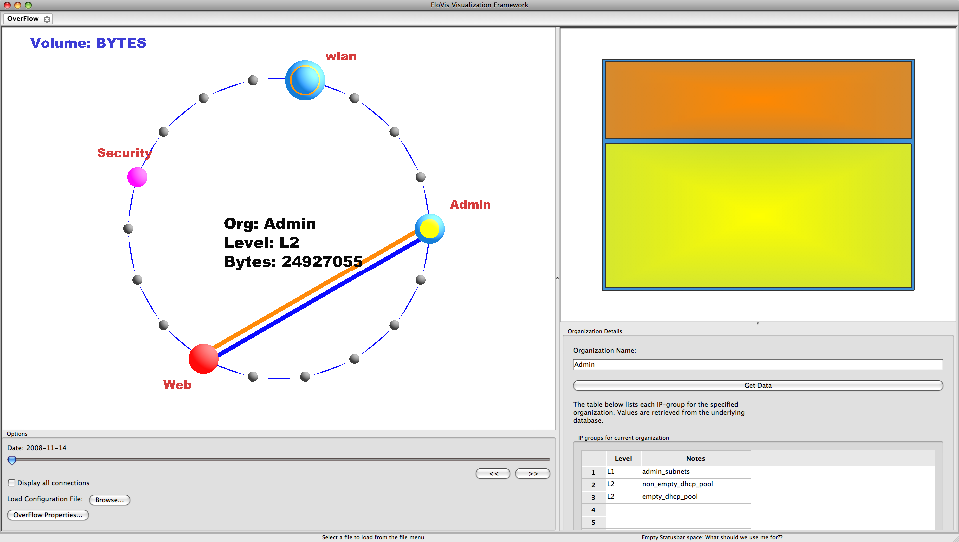
Visualizing Volumes

Slide 14
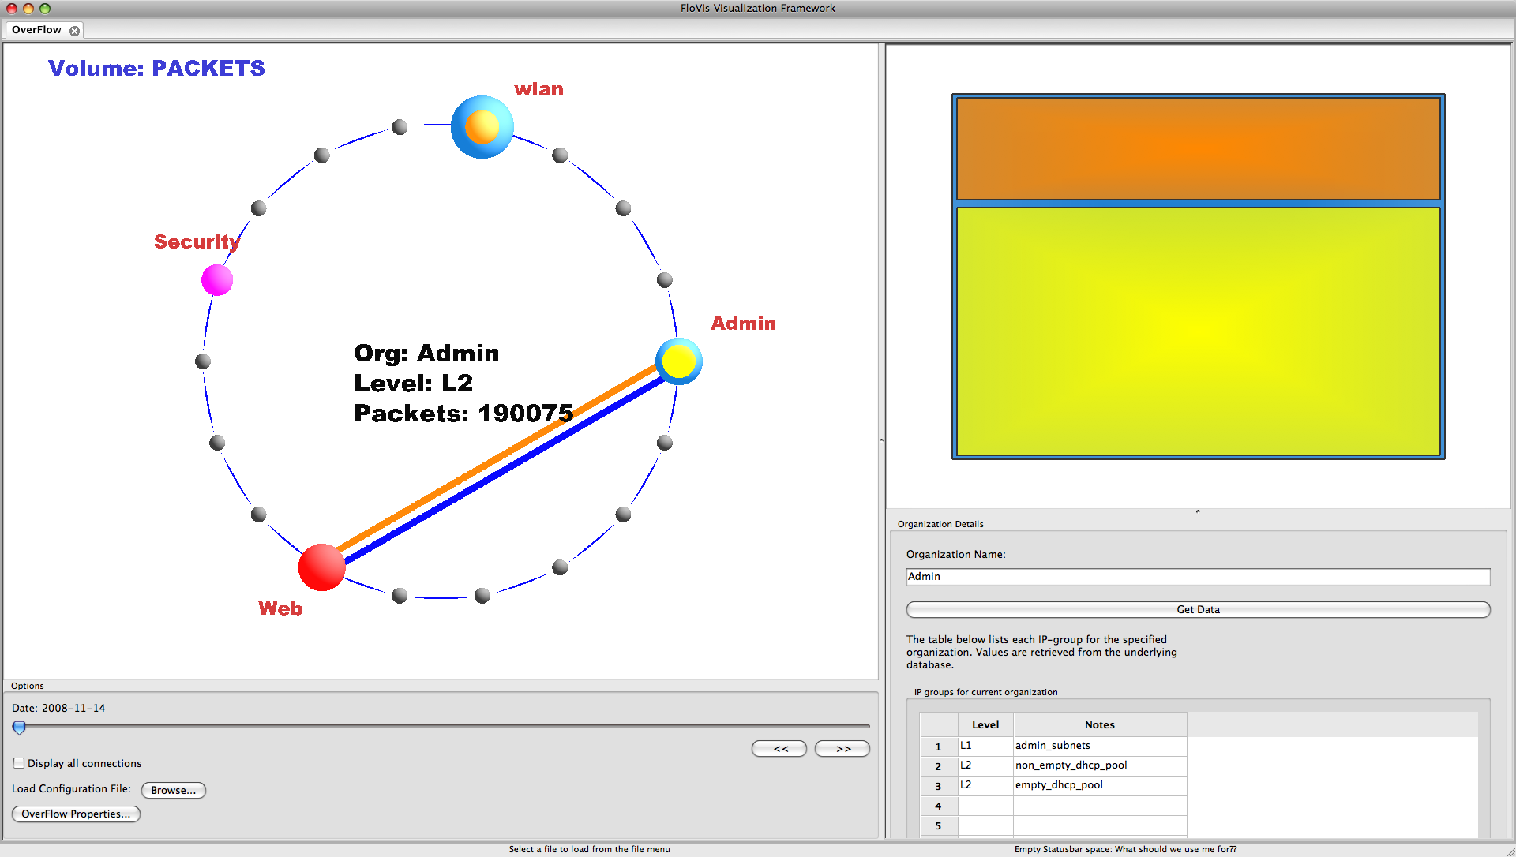
Visualizing Volumes
Notes:
We notice (from the treemap) that one of the IP-groups has the largest proportion of flows, but the smallest proportion of bytes and packets.
Is that interesting? Maybe not.

Slide 15
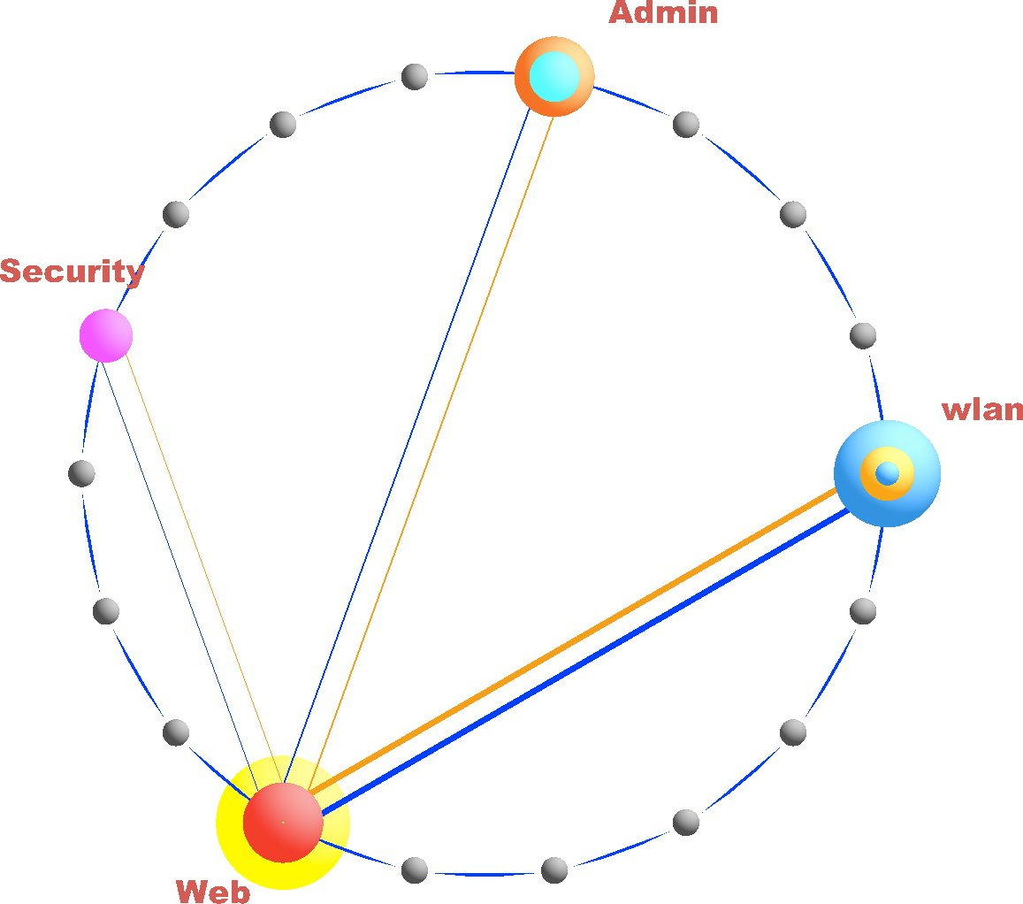
Visualizing Communications

Slide 16
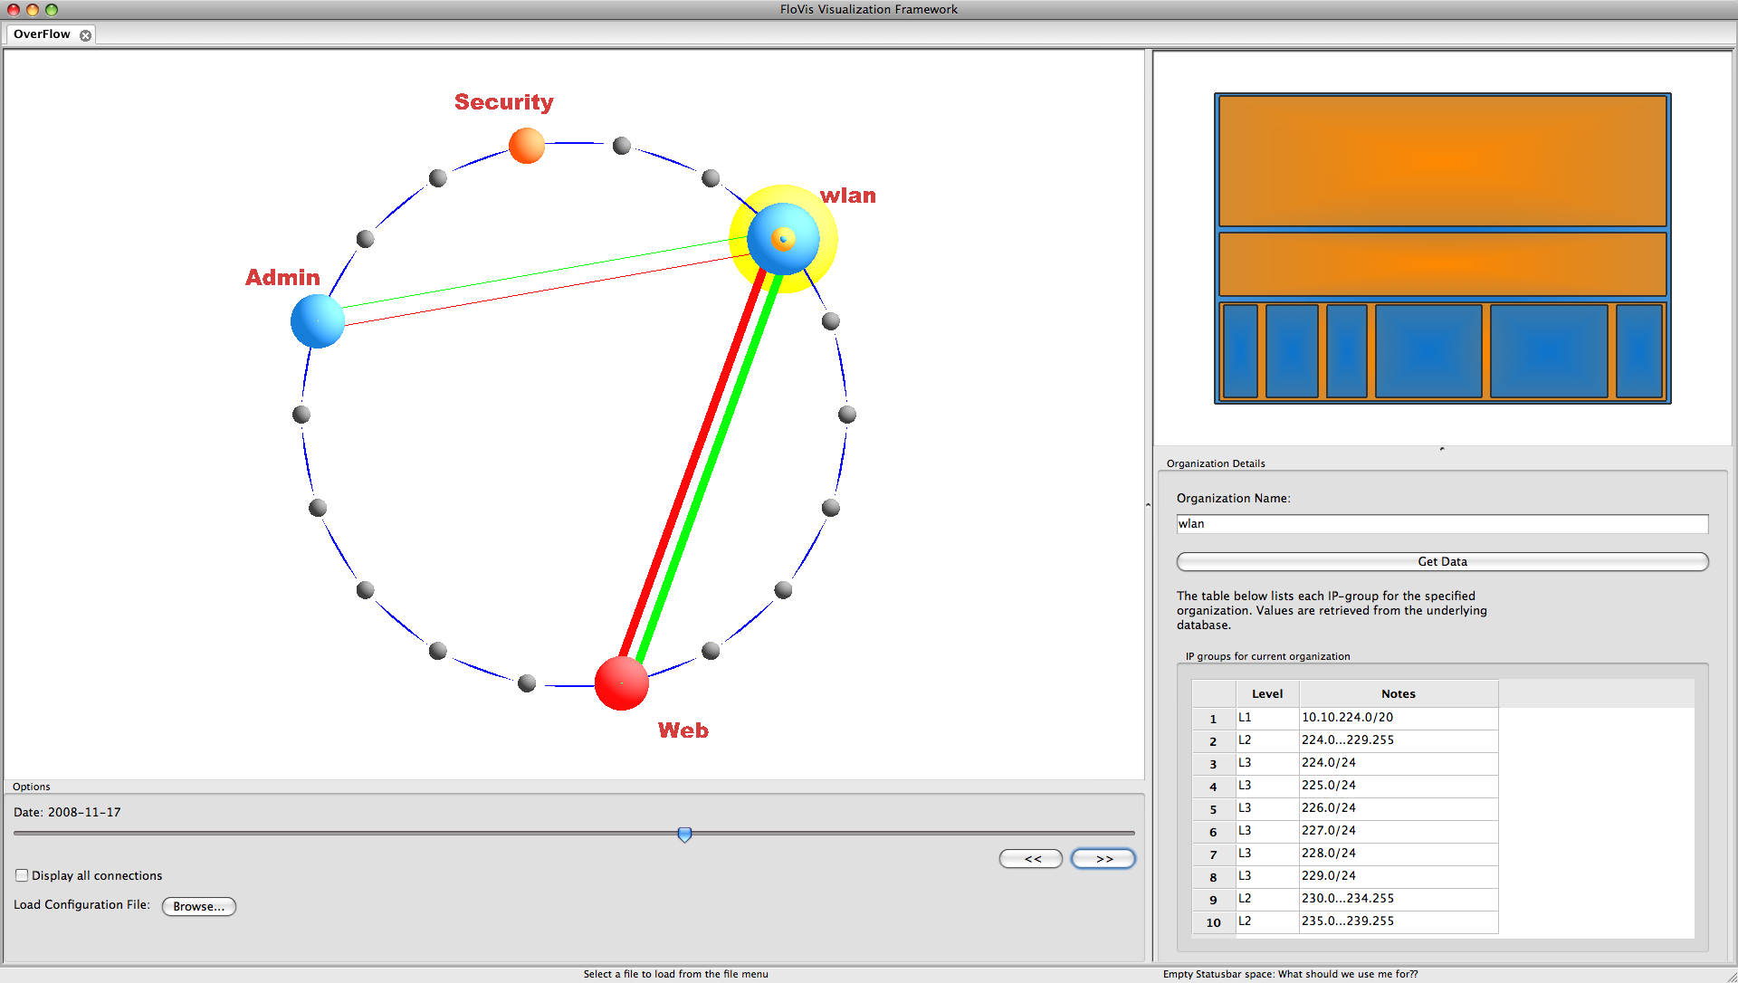
Transitioning Over Time
Notes:
- More about transitioning will be explained during the case study

Slide 17
Case Study
Network:
/17
Separated into 3 hierarchies:
Admin, Security, and wlan (public access)
1 other group introduced for ‘outside’ IPs
Data
Protocol/volume aggregates
SiLK tools used to generate protocol bags

Slide 18
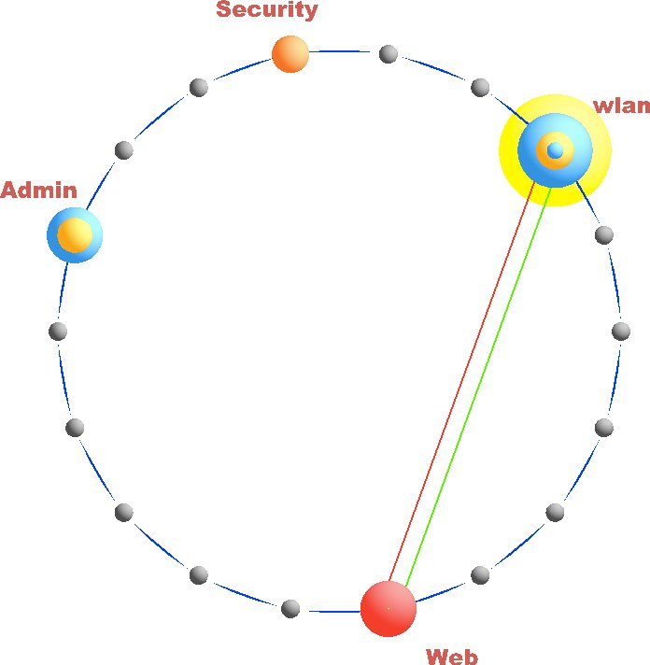
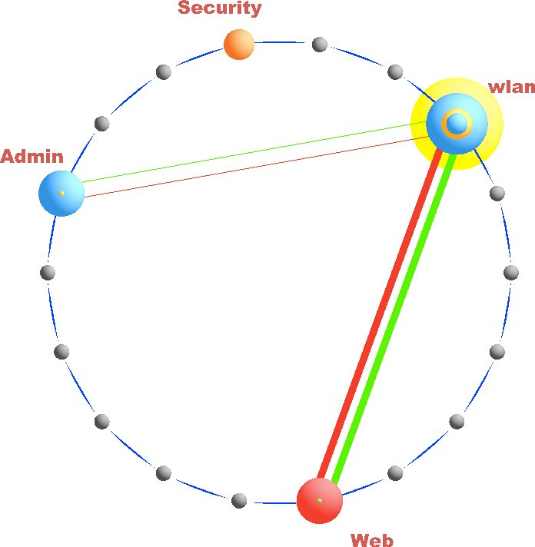
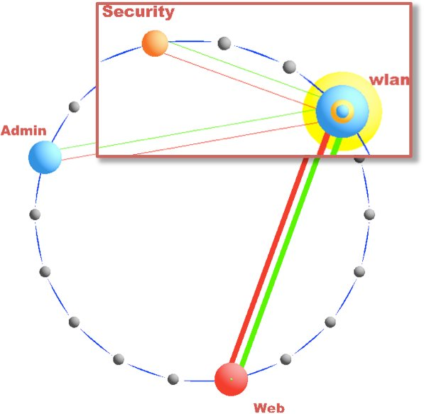
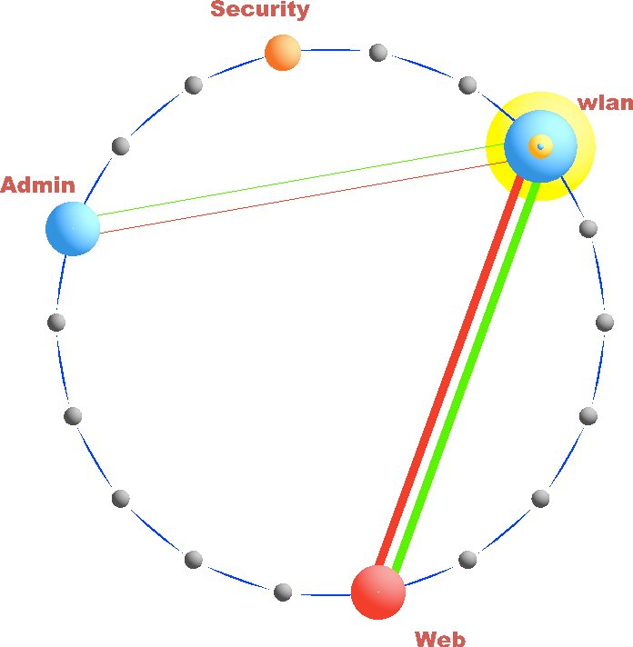
Case Study
Day 1
Day 2
Day 3
Day 4
Notes:
- Here we see that communication occurs between the Security and wlan groups. There is supposed to be no communication at all between them.

Slide 19
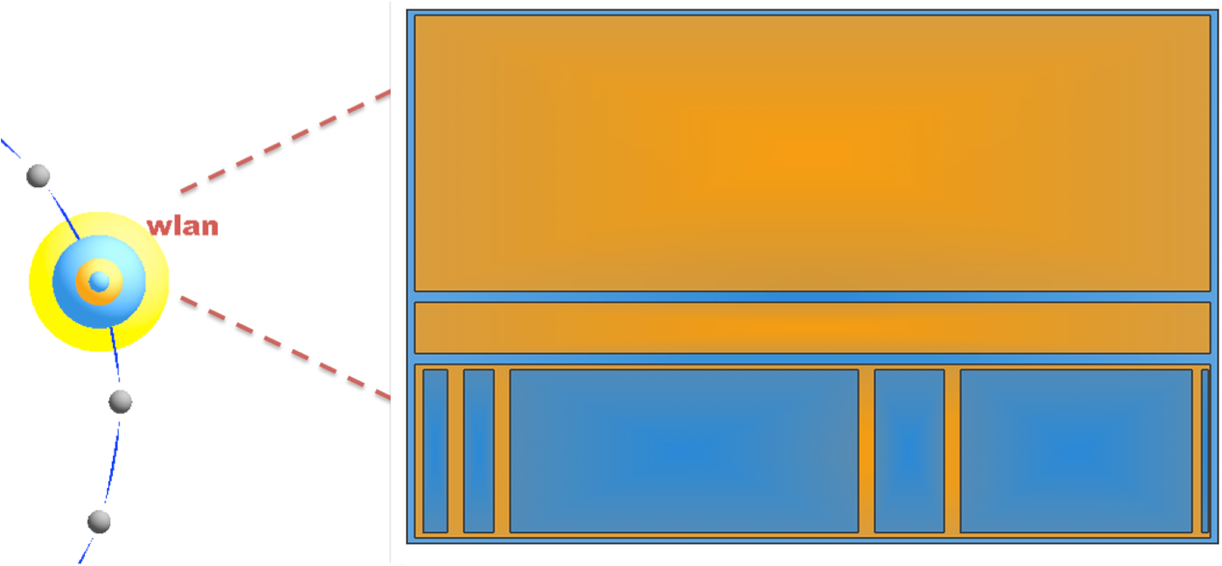
Case Study
111.222.235.167
Volume: BYTES
Should we drill down here?
Notes:
Here I discuss how the treemap might give us insight into the particular subgroup of the Security IPs that should be investigated further, since that’s where the majority of bytes is being transferred.
the next few slides are a drill down from this point down to the SiLK query tool

Slide 20
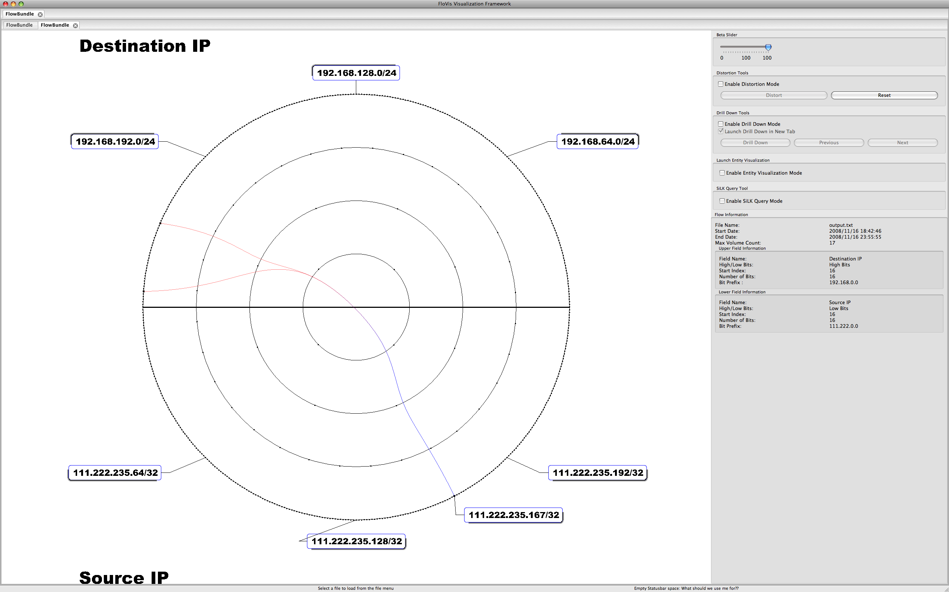
Case Study
Notes:
- Here we see that the host we selected from the TreeMap is communicating with two subnets

Slide 21
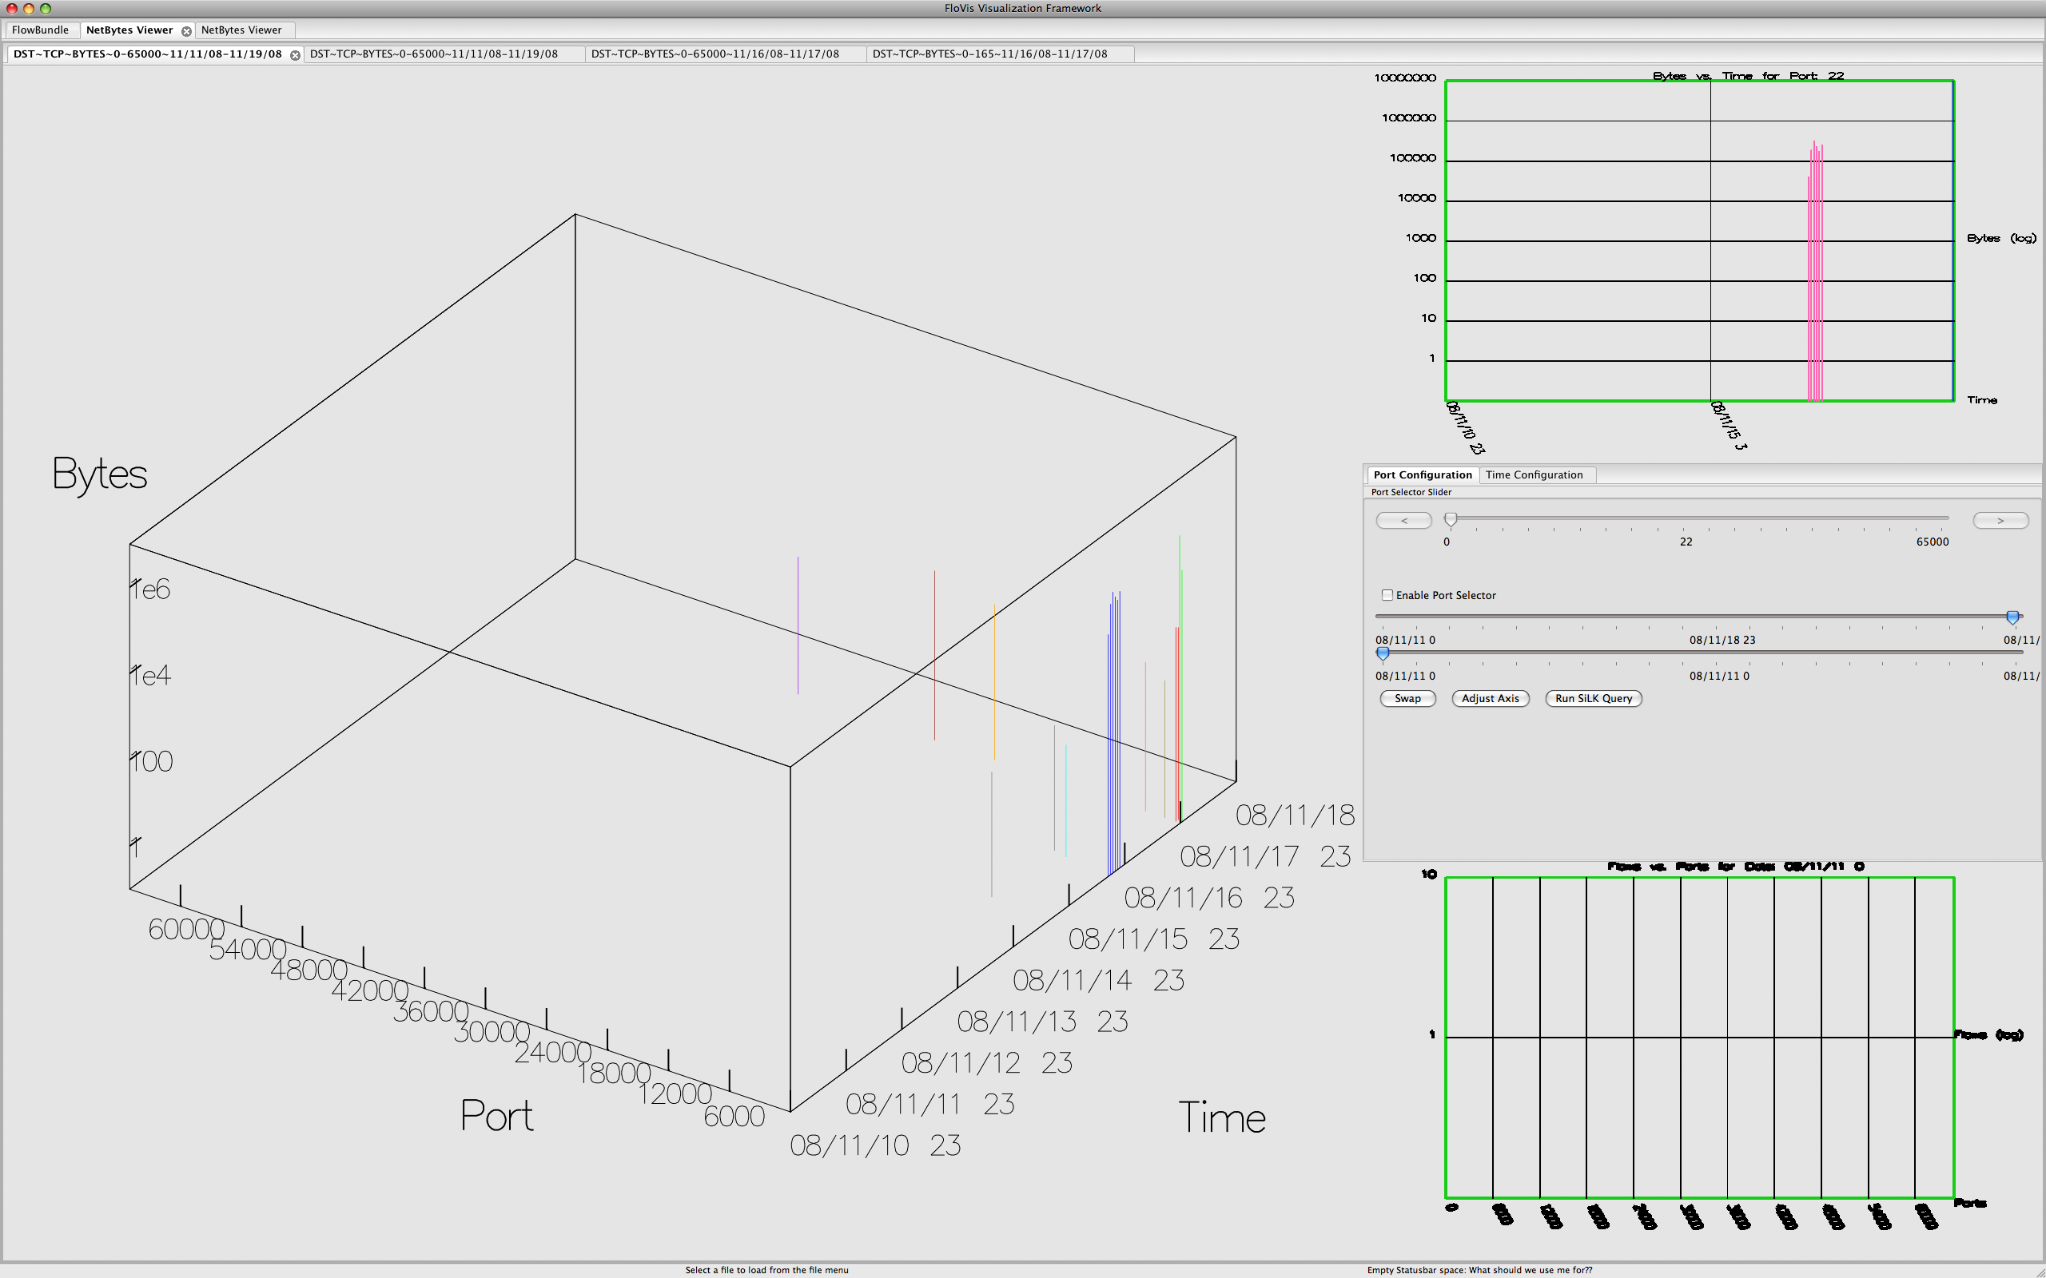
Case Study
Unexpected SSH traffic
Notes:
- The host is displaying unexpected SSH activity

Slide 22
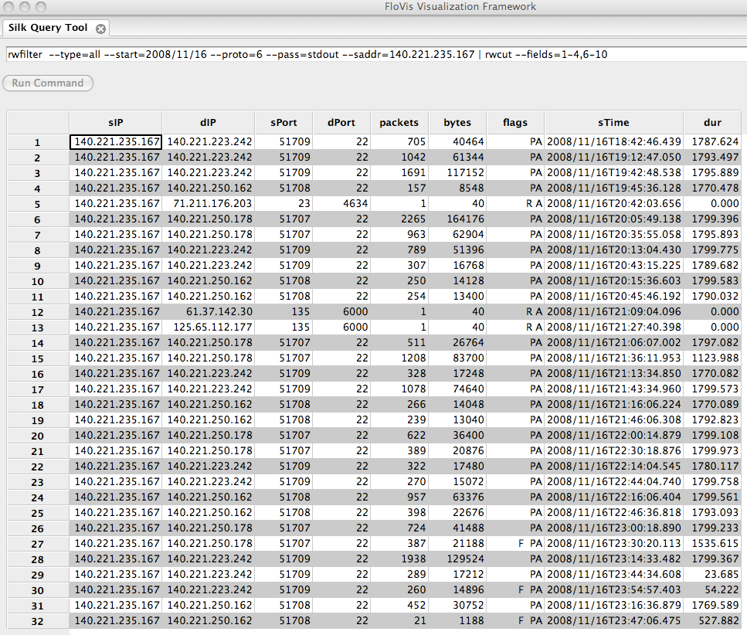
Case Study
Notes:
- SSH traffic

Slide 23
FloVis: Context

Slide 24
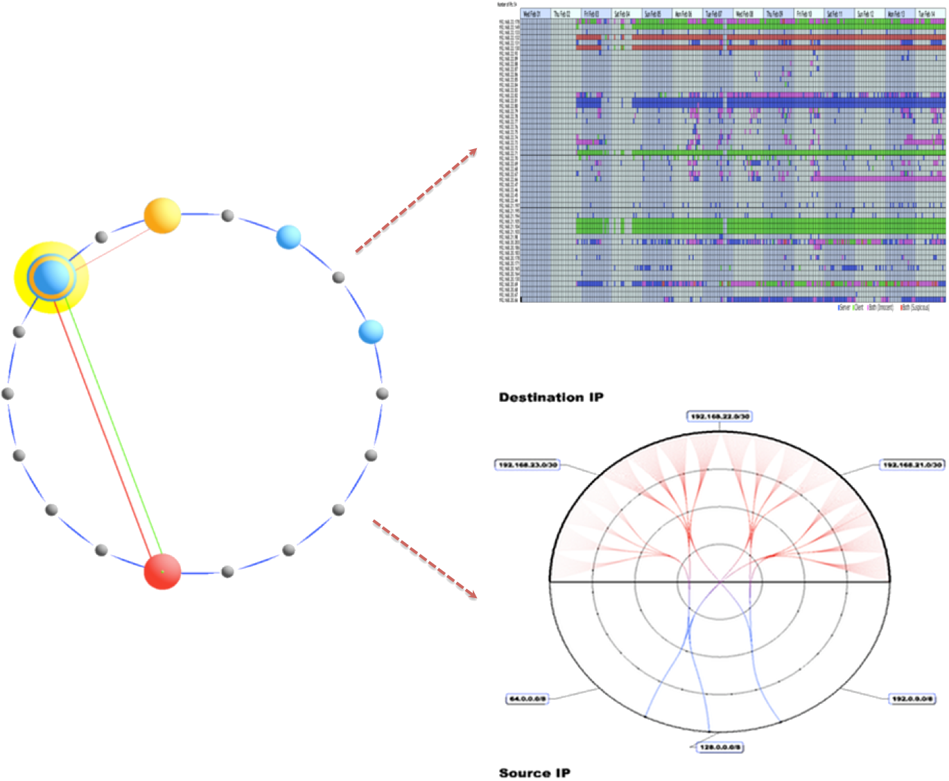
Future Work
Notes:
- This is really “In Progress” work… since Teryl has been working on allowing us to have inter-visualization communication.

Slide 25
Conclusions
Two accomplishments:
1. Overview of network hierarchies
User-defined
2. High-level view of simple communication characteristics (e.g., volumes, connections)
Assists the analyst in focusing attention

Slide 26
Learn more…
T. Taylor, D. Paterson, J. Glanfield, C. Gates, S. Brooks, J. McHugh (2009) FloVis: Flow Visualization System. In Proceedings of the Cybersecurity Applications and Technologies Conference for Homeland Security (CATCH). Washington, DC. March 3-4, 2009.
Teryl Taylor, Stephen Brooks and John McHugh. NetBytes Viewer: An Entity-based NetFlow Visualization Utility for Identifying Intrusive Behavior. In Goodall et al. (eds.), Mathematics and Visualization (Proceedings of VizSEC), Springer-Verlag, August, 2008
http://www.flovis.net
QUESTIONS?
Notes:
- What references should we include here??

